Slide 1
GPA Data Analysis
By: Shyam Narayan SolanKE
UID: 121127761
Prof: MAX Morawski
HW-5 Data602

Slide 2
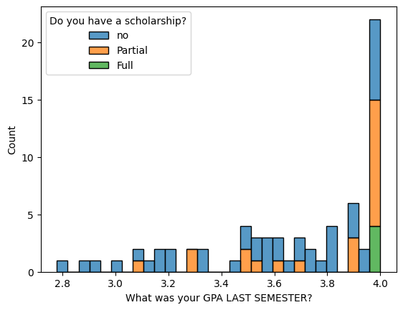

Students with low or average GPA don’t get Scholarship
Everyone getting full scholarship has GPA greater than 3.9

Slide 3
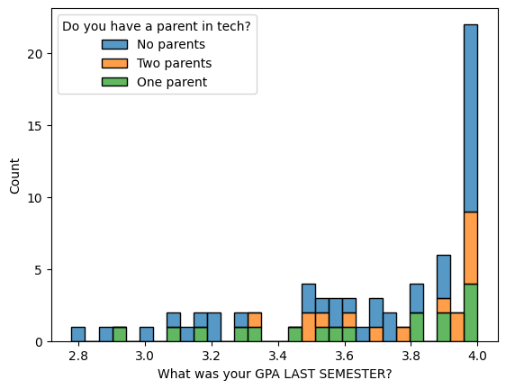
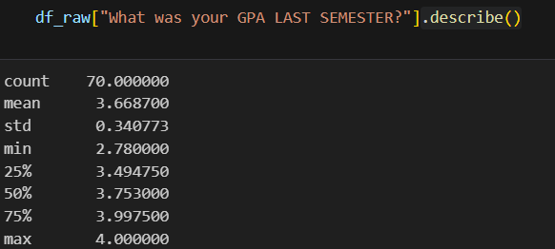


Students with Two parents most likely wont be in bottom quarter of students in terms of GPA
25% class scored less than 3.49 GPA
Below this range which is above 3.4 GPA we only have one student with both parents that means if you have 2 parents then most likely you wont be in bottom 25% students

Slide 4
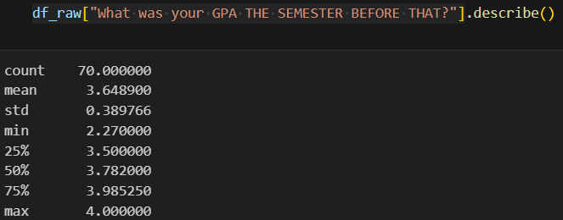
Both Semester were equally challanging
Statistics analysis shows us that both semester has similar distribution, like having similar mean, standard deviation and percentiles

Slide 5
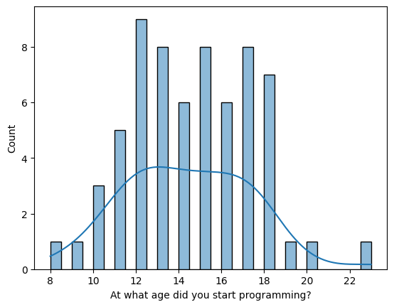
Age of Starting programming is Normally Distributed

Slide 6
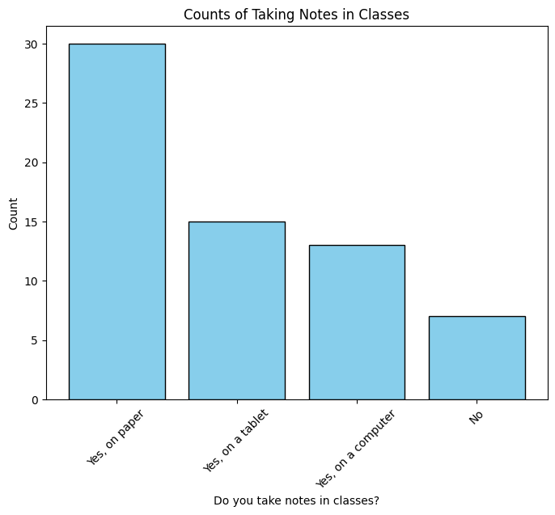

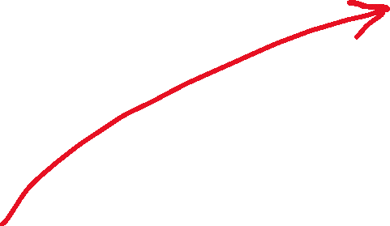


Students prefer to write notes more than typing them
Students that prefer handwritten notes
Students Prefer to type notes

Slide 7
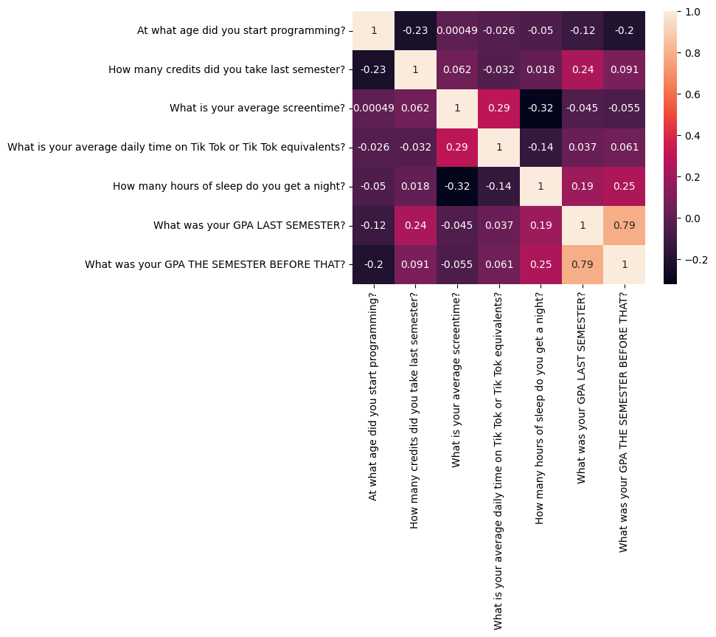

This is a correlation matrix
There is a high negative correlation between Screentime and Hours of sleep that means sleep is getting compromised in students having high screentime

Slide 8
This Correlation matrix tells us that students will score same score they scored in the semester before this as there is high correlation between GPA last semester and GPA last to last semester

Slide 9
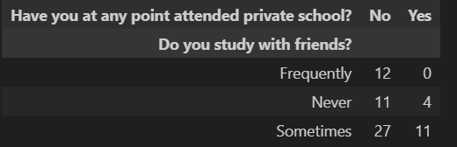
Students who have attended Private School at some point of time don’t study together frequently

Slide 10
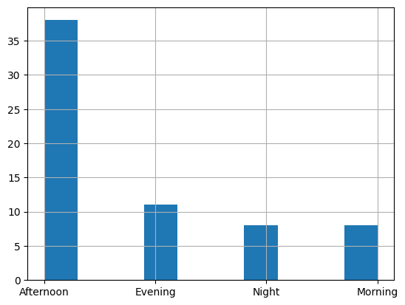
Most Surveys where filled in afternoon so most probably during a lecture

